Slide 1
TEST COLLABORATION PLATFORM OVERVIEW
GTDM
META DATA
FILES / MEASUREMENT DATA
GTDM Pre Compiler
GHOST
Config. Tool
RDM
TC Testing
Stand Alone Testing
Collaboration Platform DB & Services
(EDB Environment?)
BI Solutions (Monitoring test activities, progress, test vehicle location, ...)

Slide 2
CONFIGURATION TOOL ALT. 1
(COM INTERFACE TO EXISTING TOOLS)
?
Ultra config
EXPORT
SYSTEM SPECIFIC
DATA INSTRUCTION FILE (XML)
ID
ID
TCP
WO 2 xml
IMPORT
WO
WO
GHOST
IP Motion
RDM
WO
COMPILED WO
DESCRIPTION
SYSTEM CONFIGURATION PACKAGE
ID
IMC Devices
TCP
DeWe

Slide 3

CONFIGURATION TOOL ALT. 2
IP Motion
WO 2 xml
SYSTEM SPECIFIC
WO
WO
GHOST
Ultra Config
WO
DATA
RECOGNITION
FILE (XML)
IMC Device
DeWe
?
RDM / MANUALLY TO DEVICE
SYSTEM CONFIGURATION PACKAGE
ID
REFERENCE
TCP

Slide 4


TEST CODE BASED TESTING
EDB
MEASUREMENT SYSTEMS
TEI
(TEST EXECUTION INTERFACE)
RDM
RDM
TC MANAGER
TCP
TCP
TC DB
GTDM PC
TC SERVER
TC ANALYSIS TOOLS
(Refiner, ,,,)
TCP
PROTUS

Slide 5





WEB
INTERFACE
FOR MAINTANACE
RDM
SEWS (DTC Captions...)
GTDM PC
TCP (XML Data Recognition, ...)
TC BASED TESTING
(Non Wireless)
RDM SERVERS
DATA EXPORT
TO OTHER APPLICATIONS
(eFACTS, Safty Data, LVD, ...
VCN/CSN
EBN
DDC
VPN
(INTERNET)
GSM
PROVIDER
MOBILE DEVICES

Slide 6
RDM
DataBase
Data Presentation
Make data visible to users. Search / Viewers
Customers
Data Pre Analysis
Ex. Histogram / Reorganize / Statistics / Conversion / Mail
/ Parsing DTC
Data Distribution
FTP / WCF / MQ / Move / Copy
Other Systems /
Locations
Internal Data Storage
Data Recognition
Parse XML info to identify data
R-Sync / Data Entry
Incoming Data

Slide 7
Main functionality RDM
Manage connectivity with remote test systems (RTS) by using VCS.
Manage connectivity with RTS via VCN.
Send configurations to RTS.
Collect measurement data from RTS.
Collect metadata from RTS.
System metadata
Fleet management metadata
Recognision of measurement data.
Routing of measurement data to other applications and locations.
Sending metadata to TCP.
Fleet management data (GPS, Connection, ...)
Test progress data (No of mea, last incoming, ...)
System data (com info, ...)
Parsing DTC’s.
Create test meta data for BI.
Use extensive internal logging for system monitoring.
Sending mail to support when failure detected.
System maintenance web interface
Export data/info for GTDM upload (interface)

Slide 8
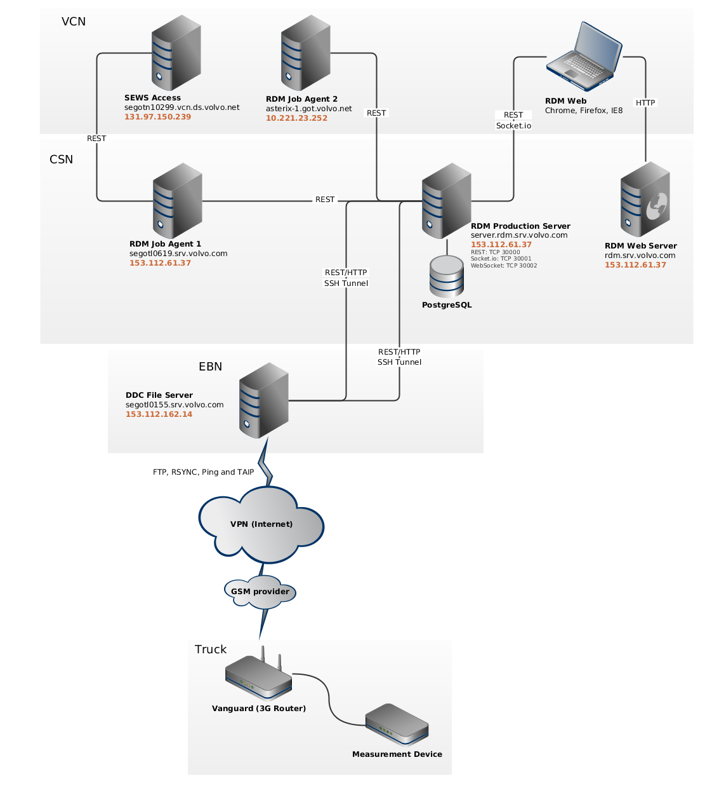

Slide 9

V&V
PROTOM
SIGNAL
LIST
(EDB)
GHOST
WORK
ORDERS
TCP

Slide 10
TestCase TESTING ”STEP 2”
TCP
GTDM PC
RDM
TCP
SERVICES
GTDM EXPORT
SERVICES
COLLECTOR
SERVICES
Test Instruction Package
NEW
VCN
VCN/4G
Test Instruction Package + RESULT DATA
NEW, RESUME, PAUS, READY
MEASUREMENTDATA
PAUS, READY
eFACTS SERVICES AND
DATA MANAGEMENT
TestCase MANAGER
IN VEHICLE
(TCP SERVICES)
TestCase ANALYSIS TOOLS
(Ex. Refiner, ,,,)
TEI
(TEST EXECUTION INTERFACE)
Mea.Sys

Slide 11
Test Case / Test Routine
Results
All data and information generated that describes the outcome of the test component.
Dynamic Info
Meta data that can be altered during the test.
Static Info
Meta data that is valid for the whole test.
Driver
Trailer Id
Logger Id
...
Vehicle Id
Vehicle Spec. + Version
Truck Function
SWR
Test
Test Leader
...
UDS
Status
Logged Data
Ok/Nok
Confirmation
Gradings
Comments
...
Logfiles
Environmental Data
Data Types
...
Post Measurement Info
Meta data that is attached after the test during analysis and post processing.
Vehicle Id readout
GPS position
Amb.Temp
Milage
...
PROTUS Report Id
Statistic Data
Correlation Info
Data Properties
...

Slide 12
GTDM INTERFACE
API FOR CLIENT APPLICATIONS
SEARCH/DOWNLOAD
GTDM
SERVER
METADATA idRef
DATA
idRef
GUI
FOR UPLOAD SERVICE
For monitorning of test progress use EDB.
For statistics reporting and KPI’s use EDB.
For MetaData directly related to test measurements use GTDM.
Not all test MetaData stored in TCP are relevant for GTDM.
API
UPLOADING MEASUREMENT DATA
INSTRUCTIONS FOR PREPROCESSING
(SEARCH & DOWNLOADING DATA)
METADATA idRef
EDB BUSINESS LAYER
COMMON SERVER APPLICATION
FOR ALL CLIENTS
RDM, eFACTS,....
DATA
idRef
TCP DB
TEST APPLICATIONS USING METADATA
AND MEASURMENT DATA
TEST APPLICATIONS ONLY USING METADATA
[GHOST, CONFIGURATIONS, ...]

Slide 13
GTDM Scenarios
Server to Server with TCP
Laptop to Server with TCP
Laptop to Server no TCP
Server to Server no TCP (Rig)
Laptop to GTDM
Adding data to existing measurements
Application to GTDM (E.g. Diadem analysis files, report files)
Files to GTDM (Photos, videos, documents, ...)

Slide 14
GTDM 1’st PHASE
GTDM
Data files structure
+ xml MetaData file(s?)
GTDM PreCompiler Server
* MetaData Compiler
Compile metadata from TCP, source app, ...
Metadata constraints, rules, ...
Metadata syntax checks and validity...
* Manage Data Structures
Unzip packages
Restructure data packages
* GUI for precompiling data from non-server measurements
with or without TCP connectivity.
* Single ponit if entry for uploding GTDM data
* Create metadata for TCP (measurement statistics, ...)
TCP
First phase: Connection to
PROTOM (Vehicle Spec)
Vehicle Id
REMARK:
Tag metadata in TCP if it belongs to GTDM or not.
Should be stated in the metadata model.
Data files structure
+ xml MetaData file(s)
Available Meta Data in eFACTS
TestObject ID (PROTUS)
Vehicle ID
Variant Spec Version (Phase)
Variant Spec (All VF’s)
Project
Test Leader
Test Type
Start Time
Measurement System ID
eFACTS, RDM
Road Data
eFacts: Mark topics to be sent to GTDM.
Data files and selected meta data.

Slide 15
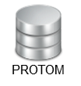
GTDM 1’st PHASE Actions
GTDM
Knowledge
Scripts
GUI (search, predefined functions [metamodel])
Plug_in’s
Data Location
Data files structure
MetaData file structure & Syntax
Communication & Protocols
TCP Implementations
Services ?
Communication & Protocols
GTDM PreCompiler Server
Service Implementations
Service Location
Data Location
GUI / Manual Upload
TCP
First phase: Connection to
PROTOM (Vehicle Spec)
Communication & Protocols
Communication & Protocols
eFACTS, RDM
Road Data
eFacts: Mark topics to be sent to GTDM.
Data files and selected meta data.
Implementations for upload

Slide 16







TEST COLLABORATION PLATFORM
GTDM PROJECT
GTDM
DASHBOARDS
GTDM PRE COMPILER
E.G
Test follow up
Test statistics
Fleet management
GUI FOR MANUAL
MEASUREMENT AND META
DATA UPLOAD
* MetaData Compiler
Compile metadata from TCP, source app, ...
Metadata constraints, rules, ...
Metadata syntax checks and validity...
* Manage Data Structures
Unzip packages
Restructure data packages
* GUI for precompiling data from non-server measurements
with or without TCP connectivity.
* Single ponit of entry for uploding GTDM data
* Create metadata for TCP (measurement statistics, ...)
MEASUREMENT DATA,
NON-TCP META DATA +
TEST-ID ...
TC SERVICES
TC ADAPTED
APPLICATION
[e.g. RDM]
Interface between applications and TC database.
Providing services for reading/writing data.
Providing funtionality for meta data management.
META DATA
APP. PERSISTENT
DATA
TC ADAPTED
APPLICATION
[e.g. GHOST]
TC DATABASE
Persistent TC data
Rules, constraints,
properties etc
MetaData Model
...
APP. PERSISTENT
DATA
PROTOM
PROTUS
TC ADAPTED
APPLICATION
RESPONSE NOT CRITICAL
OTHER SOURCES
FAST RESPONSE

Slide 17
TEST COLLABORATION PLATFORM
GTDM PROJECT
GTDM
HYPERTEST???
DASHBOARDS
GTDM PRE COMPILER
E.G
Test follow up
Test statistics
Fleet management
GUI FOR MANUAL
MEASUREMENT AND META
DATA UPLOAD
* MetaData Compiler
Compile metadata from TCP, source app, ...
Metadata constraints, rules, ...
Metadata syntax checks and validity...
* Manage Data Structures
Unzip packages
Restructure data packages
* GUI for precompiling data from non-server measurements
with or without TCP connectivity.
* Single ponit of entry for uploding GTDM data
* Create metadata for TCP (measurement statistics, ...)
MEASUREMENT DATA,
NON-TCP META DATA +
TEST-ID ...
TC SERVICES
TC ADAPTED
APPLICATION
[e.g. RDM]
Interface between applications and TC database.
Providing services for reading/writing data.
Providing funtionality for meta data management.
META DATA
APP. PERSISTENT
DATA
TC ADAPTED
APPLICATION
[e.g. GHOST]
TC DATABASE
Persistent TC data
Rules, constraints,
properties etc
MetaData Model
...
APP. PERSISTENT
DATA
PROTOM
PROTUS
TC ADAPTED
APPLICATION
RESPONSE NOT CRITICAL
OTHER SOURCES
FAST RESPONSE

Slide 18
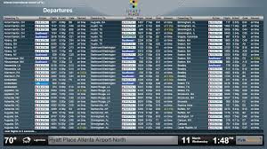

TEST COLLABORATION PLATFORM
SECURE THAT OUR TOOLS SUPPORTS THE PROCESS (PLAN & PERFORM TEST)
ENSURE THAT WE HAVE TOOLS THAT COVERS THE PROCESS
CREATE INTERFACES TO ENABLE INFORMATION EXCHANGE BETWEEN TOOLS
CREATE AN ENVIRONMENT TO CARRY TEST INFORMATION IN A STRUCTURED AND HARMONIZED WAY
CREATE BI SOLUTIONS FOR MONITORING STATUS AND PROGRESS OF TESTS AND TEST OBJECTS
TCP DATABASE & SERVICES
BI SOLUTIONS
12:38
12:38
http://www.windowsphone.com
http://www.url.com/
1

Slide 19
DATABASE PRE-SYNCHRONISATION
Synchronize all tables needed for offline work into a temporary local database.
The synch. cannot be to old to be valid.
COLLECTOR IN OFFLINE MODE
Meas. Data presented as usual (MeasData folder)
Do consistency checks on files. ”Duplicates” can not be checked at this time.
Vehicle/System must be initiated before database synch.
Offline collector should hold the organizer functionallity to prepare data for the Refiner.
REFINER IN OFFLINE MODE
Not possible to load from database.

Slide 20
GTDM – Metadata Integration

Slide 21
Long term solution

Slide 22

Sol 1: Merge metadata in GTDM Tools
Number of process to create global metadata file:
1 loadramp for Measurement file + Test Metadata File
5 Loadramps for Ref Source application (PROTOM, GHOST…)
1 merge on GTDM tools
Question: Capacity from tool to merge metadata?
Loadramp
GTDM
Measurement File
Test Metadata File (XML common format)
GHOST
Metadata
TCP Exchange Process
Loadramp
Metadata Model
PROTOM
Metadata
Loadramp

Slide 23
Sol 2 Merge metadata in TCP exchange process
GTDM
Test Metadata File (common format)
TCP Exchange Process
Loadramp
GHOST
Metadata
Global Metadata File (XML common format)
PROTOM
Metadata
Measurement File
Number of process to create global metadata file:
1 loadramp for Measurement file + Test Metadata File
Question: Capacity for TCP project to merge metadata from ref metadata and test metadata?
Issue: Synchronisation of data after the first integration (For exemple, how reload new GHOST information update after test)
Metadata Model

Slide 24
Short term solution
TCP could not supported on short term solution implement on 2016.

Slide 25
Merge metadata in test applications (EFACTS, RDM…)
EFACTS/RDM
GTDM
Test Metadata File (common format)
Loadramp
Global Metadata File (XML common format)
PROTOM
Metadata
Measurement File
Other
Metadata
Metadata Model

Slide 26


Sol 1: Received specific extraction from PROTOM
EFACTS/RDM
GTDM
Test Metadata File (common format)
Loadramp
Measurement File (included Metadat)
Measurement File
Metadata
Test Object ID
Variant Fam + Variant
PROTOM Metadat
Metadata Model
PROTOM

Slide 27

Sol 2: Reuse common service from PROTOM
EFACTS/RDM
GTDM
Test Metadata File (common format)
Loadramp
Measurement File (included Metadat)
Measurement File
PROTOM Metadata
Metadata
Metadata Model
PROTOM

Slide 28
Sol 3: Implement manual solution
EFACTS/RDM
GTDM
Test Metadata File (common format)
Loadramp
Measurement File (included Metadat)
Measurement File
PROTOM Metadata
Metadata Model
Manual extraction??

Slide 29
Sol 4: Reuse common meta data service
GTDM
EFACTS/RDM
Loadramp for each file format
(avoid update)
Measurement File
Measurement File
Test Metadata File (common format)
Test Metadata file (e.g. html)
Enriched with relevant metadata
Metadata Model
General service between GTDM / TCP
???
TCP (EDB?)
E.g.
Vehicle spec
SW/HW
Test WO
PROTOM/VCE system

Slide 30
Sol 5: Reuse common meta data service
GTDM
EFACTS/RDM
Loadramp for each file format
(avoid update)
Measurement File
Measurement File
Test Metadata File (common format)
Test Metadata file (e.g. html)
Enriched with relevant metadata
Metadata Model
General service between GTDM / TCP
Metadata
& TestId
???
Should measurement files be sent to ”General Service” or direct to GTDM location ???
TCP (EDB?)
E.g.
Vehicle spec
SW/HW
Test WO
PROTOM/VCE system

